Slide 1

Advanced Convolutional Neural Networks
1
4
Things might get complicated

Slide 2
14.1
Convolution.

Slide 3
What is Convolution?
Convolution in Convolutional Neural Networks (CNNs) is a fundamental operation used to extract features from input data, such as images
Convolution involves applying a filter (also known as a kernel) to the input data. This filter is a small matrix
14.1. Convolution.

Slide 4
Concepts in Convolution
Sliding Window: The filter is moved across the input image (or matrix) step by step. This process is often referred to as the sliding window technique
Element-wise Multiplication: At each position, the filter performs element-wise multiplication with the part of the image it covers
Summation: The results of these multiplications are summed up to form a single output pixel in the feature map (also called the convolved feature)
14.1. Convolution.

Slide 5
Concepts in Convolution
Filters: The values in the filters are learned during the training of the network. Initially, they are set randomly.
Multiple filters are often used in each convolution layer, each detecting different features
14.1. Convolution.

Slide 6
Concepts in Convolution
Feature Map: This process is repeated across the entire image, producing a feature map that represents certain features of the input image, such as edges or textures
Depth of Filter: In the case of RGB images, the filter extends through the depth of the input (covering all color channels), and the same convolution operation is applied
14.1. Convolution.

Slide 7
Concepts in Convolution
Strides: The filter can move a certain number of pixels each time (called a stride). A larger stride means the filter jumps over more pixels at each step and produces a smaller feature map
Padding: Sometimes, padding is added to the input image (typically with zeros) to allow the filter to fit properly at the edges. This helps in controlling the spatial size of the output feature map
14.1. Convolution.

Slide 8
14.2
Pooling Layers.

Slide 9
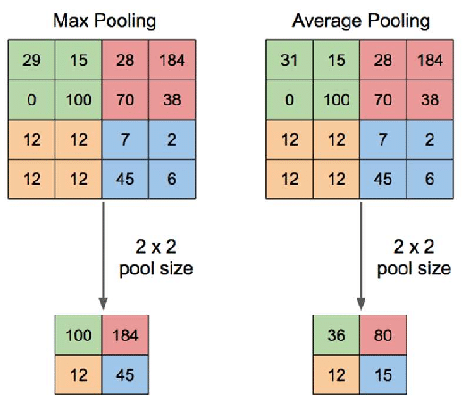
Pooling Layers
14.2. Pooling Layers.

Slide 10
Pooling Layers
Dimensionality Reduction: Pooling layers reduce the spatial dimensions (width and height) of the input volume for the next convolutional layer. It helps to decrease computational load and memory usage
Pooling Window and Stride: Similar to convolutional layers, a pooling layer has a window size that moves across the feature map with a certain stride
14.2. Pooling Layers.

Slide 11
Types of Pooling Layers
The most common pooling method is max pooling, which takes the maximum value in each window of the feature map.
Average pooling, taking the average value, is another method
14.2. Pooling Layers.

Slide 12
14.3
Training Overview of CNNs.

Slide 13
General Training Process
1. Forward Pass: Input data is passed through the convolutional and pooling layers. Each layer applies its filters and activation functions to process the data
2. Activation Functions: After each convolutional and pooling layer, an activation function like ReLU is applied to introduce non-linearity
14.3. Training Overview of CNNs.

Slide 14
General Training Process
3. Fully Connected Layers: After several convolutional and pooling layers, the high-level reasoning is done by fully connected layers that use the extracted features for classification or regression tasks
4. Loss Calculation: At the output layer, the network’s predictions are compared to the actual target values using the loss function
14.3. Training Overview of CNNs.

Slide 15
General Training Process
5. Backpropagation: The network learns by backpropagating the error, adjusting the weights of the filters in convolutional layers and neurons in fully connected layers
6. Weight Update: Using optimization algorithms (like SGD, Adam), the weights are updated to minimize the loss function
14.3. Training Overview of CNNs.

Slide 16
14.4
Computational Costs of CNN.

Slide 17
Consider Computational Costs
The computational cost of Convolutional Neural Networks is a significant consideration
Especially when dealing with large networks and high-resolution input data
14.4. Computational Costs of CNNs.

Slide 18
Factors Influencing Computational Cost
Size of Input Data: The resolution and dimensions of the input data
Number of Layers: More layers in a CNN mean more computations
Number of Filters in Convolutional Layers: The number of filters (and their size) in each convolutional layer determines the number of operations required to compute
14.4. Computational Costs of CNNs.

Slide 19
Factors Influencing Computational Cost
Stride of Convolution: A larger stride reduces the spatial dimensions of the output feature maps, thus reducing the number of computations
Pooling Layers: Pooling layers reduce the spatial dimensions of the feature maps, which can decrease computational cost in subsequent layers
14.4. Computational Costs of CNNs.

Slide 20
Factors Influencing Computational Cost
Fully Connected Layers: These layers, typically found near the end of CNNs, can have a high computational cost, especially if they have a large number of neurons
14.4. Computational Costs of CNNs.

Slide 21
Computational Challenges
Memory Usage: CNNs can require significant memory, especially for storing the weights and activations at each layer
Training Time: Training deep CNNs can be time-consuming, particularly on large datasets
Inference Time: The time it takes for a trained CNN to make predictions on new data can be crucial for applications that require real-time processing
14.4. Computational Costs of CNNs.

Slide 22
14.5
Mitigating Costs.

Slide 23
Mitigation Strategies
Network Pruning: Removing redundant or non-contributing neurons and connections to reduce network size without significantly affecting performance
Transfer Learning: Using a pre-trained network and fine-tuning it for a specific task can save computational resources, as the network has already learned general features
14.2. Pooling Layers.

Slide 24
Mitigation Strategies
Efficient Architectures: Some architectures, like MobileNets or EfficientNets, are designed specifically to reduce computational costs while maintaining high performance
Distributed Computing: Distributing the training process across multiple machines can also help manage the computational load
14.2. Pooling Layers.

Slide 25
END.

